Slide 1

Due Diligence Kick-Off
Introduction & Process Overview

Slide 2
We’re excited to be here!
Who’s helping
“The Squad”
  While the meetings right now include us, we’ve got a full team
  We will all work together to gather information and answer Q’s
  Let’s make sure that we’ve got the whole team
What we’re doing
“Process”
  Accountants and attorneys will be reviewing your books & records
  We’ll deliver a purchase agreement to you in ~45 days
  We’ll aim to close by the end of [Target Closing Date]
  Let’s make sure the dates make sense
How we do it
“Check-ins” & “Sessions”
  We follow a regular format that allows everyone to stay in sync
  You will only have one document to focus on: our “Q&A Doc”
  We save everything down into our “data room”
  You will have a consistent sense of our timeline
  Let’s make sure you have access to the folders and documents
Our goal is to conduct an efficient due diligence process (and have fun while we’re at it!) so that we can sign a purchase agreement and start our partnership

Slide 3




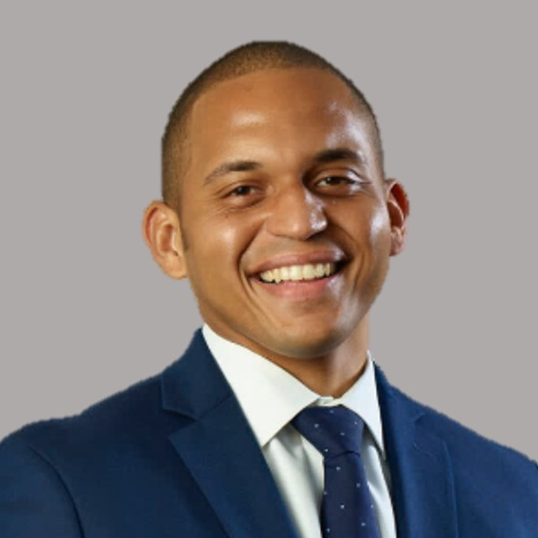






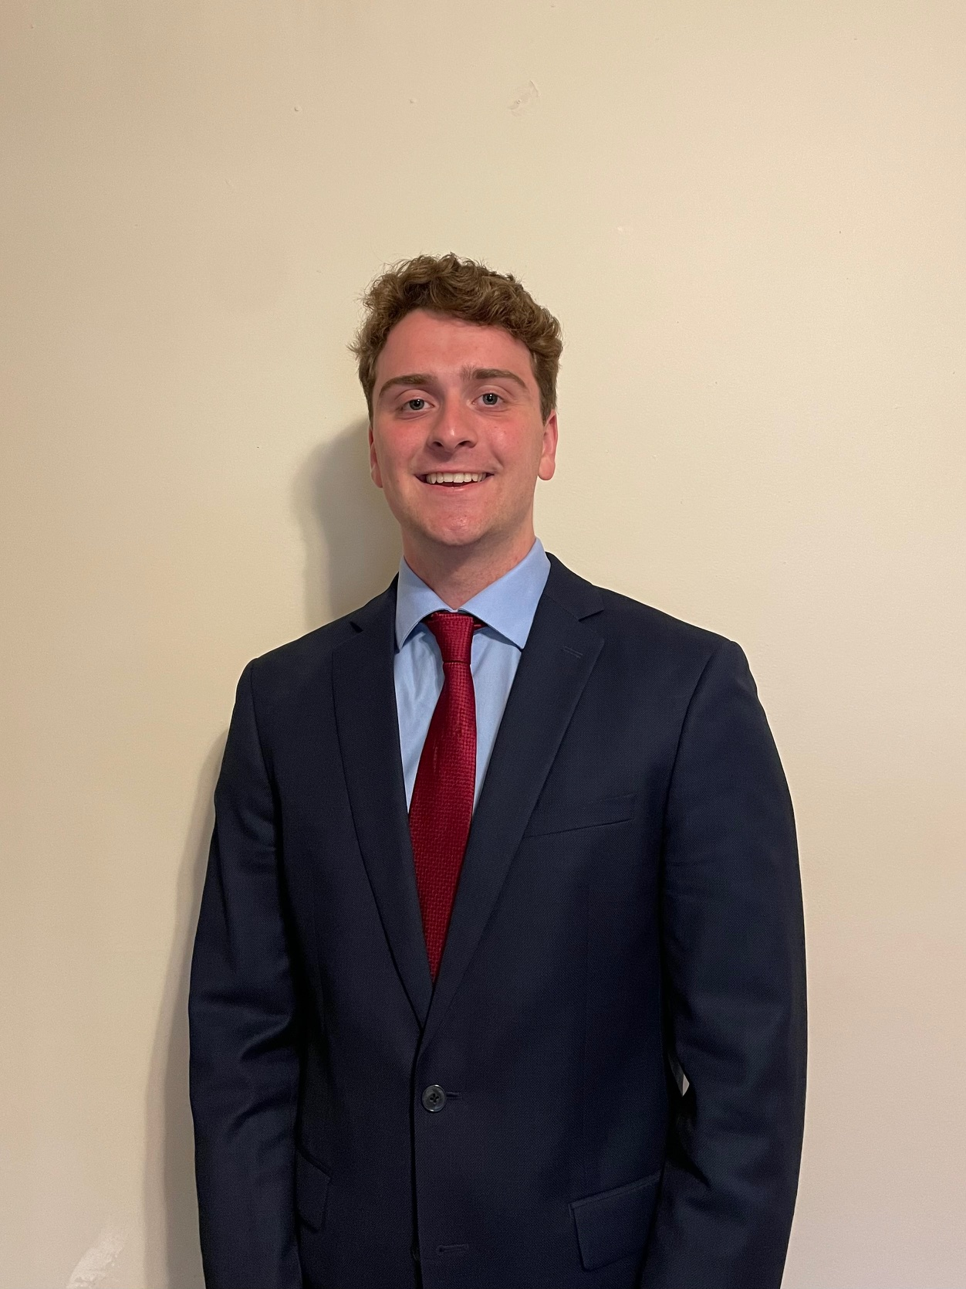
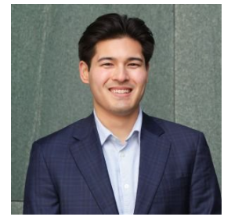
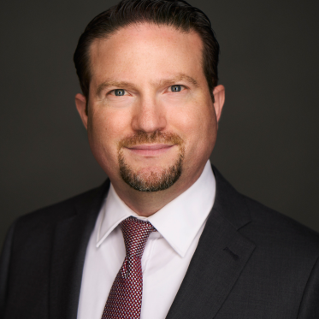

The Squad: Putting a face to the names of our diligence team and partners
(Accountants & Tax Specialists)
(Legal)
Orlando Remak
Co-Founder
Brent Straitiff
Partner
Brian Drue
Partner
Justin Eggimann
Manager
Corey Dickey
(Insurance)
Aidan Donaldson
M&A Manager
Max Boulton
M&A Analyst
Soren Hawkins
Senior Associate
Avi Goodman
Managing Director
Allen Hudson

Slide 4
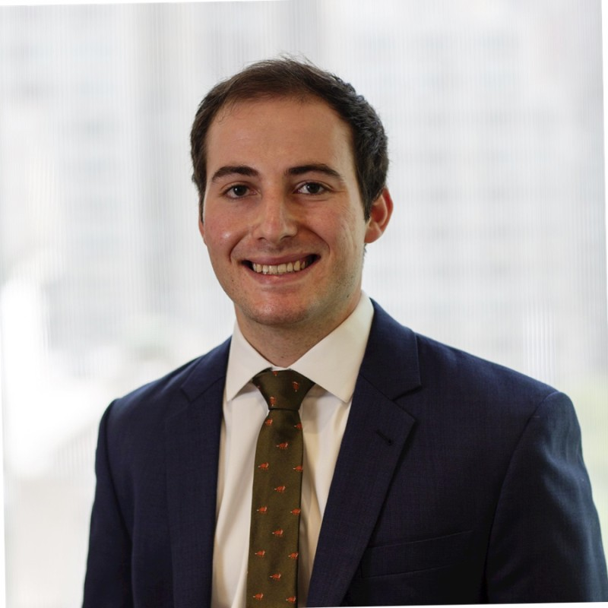
The Squad (cont’d): We’re here to help and here’s how we typically split work
Phase | Who you’ll see the most | What will we be doing? | Point of contact
Data Collection |  | Bi-weekly check-ins Debugging data room set-up Gathering information | Doris Katie
DD Sessions |  | Bi-monthly DD sessions Interpreting the data Sharing our findings | Doris Katie
Legal Diligence |  | Deliver initial drafts “Issues List” discussion Hashing out all agreements | Doris Katie
A Few Key Topics we will Cover During Legal Diligence:
  Employees & HR compliance (agreements, policies, handbook/I-9)
  Litigation, investigations & disputes (history, subpoenas, outstanding orders)
  Real estate/lease & insurance obligations (coverage limits, additional insurance needed)

Slide 5
Process: We should be in position to close by the end of November
Business Review
  Review customer, employee, and financial information
  Discuss operations, org structure, company history, etc.
  We can complete this in mid-October
Accounting Review
  Accounting review session
  Refresh of financial information
  We can complete this in mid-October
Legal Review
  Receive contracts, insurance policies, and benefits plans
  Completion of legal diligence session
  We can complete this by the end of October
Legal
Negotiations
  Draft, review, and revise deal documents (purchase agreement)
  Complete disclosure schedule
  We can complete this by the end of November
As long as everyone here is engaged and we’re hitting our deadlines, we should be in good shape to close by the end of November

Slide 6
Process (cont’d): Our meetings will usually follow one of these formats
Check-In
Work planning
  15 to 30-min meeting scheduled regularly on the same day/time
  Follows a similar format each time
  Keeps us in sync on what is needed to keep with progress
  These meetings will have an AI notetaker present
Time permitting, we can use check-in meetings to ask diligence questions
Diligence Session
Deep dives
  60+ min meeting to discuss a specific topic (Ex. Talent planning)
  Usually requires information ahead of time
  Follow-ups are scheduled at the end of the initial session, based on remaining open questions
  These sessions will be recorded (for our diligence partners)
Debugging
“How do I do that again..?”
  One-off meetings or calls to help with any issues
  Just call, email or text and we will help you
  Example: You text “I get an error when I enter info in this google sheet” -> we video chat asap to walk through it together live
  These meetings may be recorded (if it helps others in the future)
Max’s cell:
(513) 461-3053

Slide 7
Check-ins: We establish a regular cadence to discuss what’s needed
Don’t worry about the “messiness” of the data. Just find it and drop it in!
At the check-in:
  We assign or answer any unanswered Qs in Q&A doc
  We discuss open data requests
  We discuss status of analyses
  TCC reviews diligence timeline and re-schedules sessions, if necessary
Between check-ins:
    We locate data, save it in data room, update our analyses
    TCC reviews, adds Qs to Q&A doc, prepares list(s) for DD sessions
    TCC updates Q&A doc with near-term open Q’s and to-do’s
    TCC updates the board on progress
To discuss:
  What day/time works for our check-ins?
  Who will be attending the check-in meetings?

Slide 8
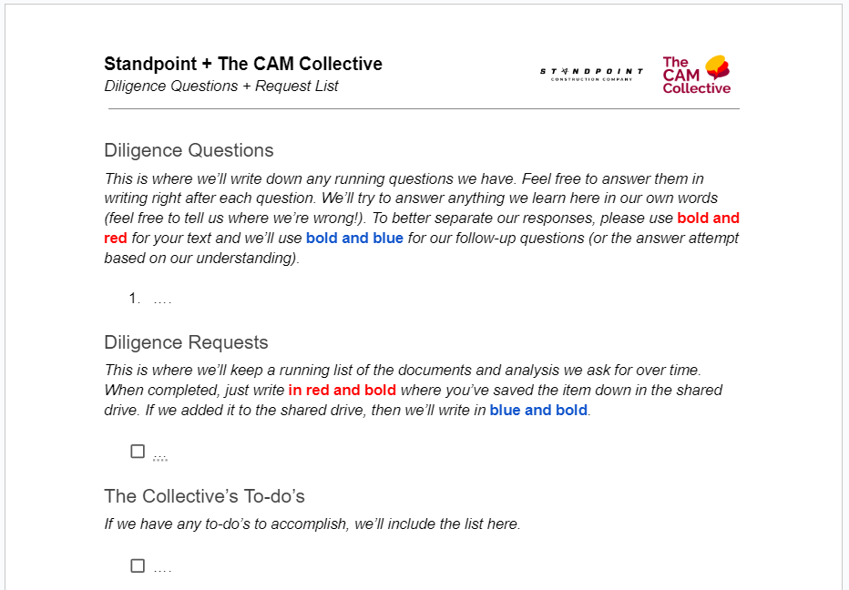
Check-ins (cont’d): “Q&A Doc” is our go-to source for latest Q’s and to-do’s
Our answer to “what do I do next?” is simple: “check the Q&A Doc”
  We use a collaborative Google document to keep on top of:
    One-off DD questions that aren’t a part of an upcoming session
    Open request items that are due or soon to be due
    Any items that we owe you
  During our check-ins, we will typically start by reviewing this doc
Spinnaker + The CAM Collective
To discuss:
  Accessing our Q&A Doc
  Walk through how to use the document in practice

Slide 9
Check-ins (cont’d): Our data room has everything we’re working on
We limit the amount of inbox digging everyone has to do by housing all data, analyses, to-do’s and questions in a single, collaborative virtual “data room”
  We’ve given you all access through a single Google account. Save the password somewhere where you can all see – just in case someone changes it!
Our data room is broken out into focus areas: Customers, Employees, Financial, and Legal
  Please save all info in those core folders (ideally in the appropriate subfolders).
  “TCC” folder is where we’ll save anything that we owe you. We’ll typically send a link to that document in our emails, vs. attaching the document
  “Diligence Meetings” folder is where we’ll save diligence session question lists we (or our accounting/legal diligence partners) write and diligence session recordings
To do / discuss:
  Access the data room using your @camcollective.com email address

Slide 10
Diligence Sessions: Our sessions typically fall into three buckets
How healthy is the company’s relationship with its customers and employees? Is it poised to grow well into the future?
How healthy are the finances, historically? What accounting process and controls are in place today? Are all taxes paid?
What is the company’s legal structure today? What liabilities has the company faced before? What is expected?
Example sessions:
      Retention analysis
      Customer health
      Employee talent assessment
Example sessions:
      GL review
      Accounting policy
      Financials review
      Tax review
      Revenue, payroll proof
Example sessions:
      Contract review
      Historical and pending customer, employee, and tax liabilities
      Review of schedules

Slide 11
Sessions (cont’d): CDS team will be working on a review of the numbers
CDS is our CPA squad!
  They are a nationally recognized accounting and advisory firm; a small team of CPAs help us
  They will be reviewing the company’s financial performance and validating EBITDA
  We will add their request list into our Q&A doc to help consolidate our open items
  They will join our check-in meetings as needed to request data and answer any questions
CDS Process
  After an initial set of information is provided, they will host a session to discuss accounting policies, procedures, and any estimates or assumptions included in EBITDA
    We’ll send you a short-list of items to send ahead of time in our Q&A doc
  Following the meeting, there will be one-off questions covered in the weekly check-ins
To do / discuss:
  Schedule time for our 90-minute accounting session (week of September 15th?)

Slide 12
Sessions (cont’d): Our legal team will be reviewing company records
Legal diligence overview
  We work Corey to help us complete legal diligence
  He will be reviewing the company’s records and understanding what legal risks remain
  We will add parts of his request list into our Q&A doc to help consolidate our open items
  Any legal diligence sessions happen towards the end of the accounting review, after we’ve delivered a draft of the purchase agreement to you
Our legal process
  Corey will be focused on reviewing your contracts and answering the questions in his diligence list around near-term and upcoming litigations or legal issues
  After we deliver the purchase agreement, we will host a call between attorneys to discuss the responses to the request list; afterwards, we will focus on negotiating the documents
  We may convert our weekly check-ins to meetings discussing open legal items
To do / discuss:
  Schedule time for legal DD session (week of October 1st?)

Slide 13
All that said…
We’re flexible
  Let’s adjust this process where it makes sense and make sure it works for all of us
  We want to get to know you and vice versa (tell us how you prefer to do that!)
We know you have a business to run
  It’s in everyone’s best interest for you to be able to keep doing this
  We’ll ask questions you may not have answers to; no problem—if it’s necessary, we’ll dig into it later
  Wherever we can minimize the burden on you, we will (e.g. cleaning raw data)
  … in fact, it’s probably most efficient if you provide us “reviewer” logins to your accounting & payroll software so we can pull data for you (it saves a lot of time)
What’s first?
  Start populating the data room with lists the accountants & attorneys provided
That’s it! Now that we’re kicked off, we’ll see you at our first check-in meeting!

